Slide 1
Erasmus+ Programme
,,Future Career? Touch IT!”

Slide 2
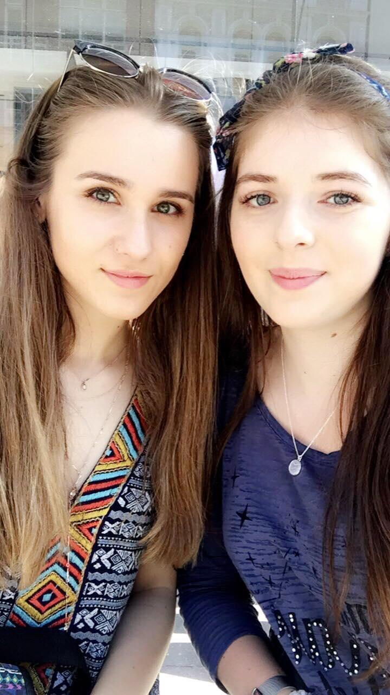
Team Irina & Andreea
18 years old
Romania
Students, that are part of the Erasmus+ Programme
Passionate about Information Technology (IT)

Slide 3

ROcycle's goal is to promote recycling in Romania. We want to bring awareness to the disastrous impact caused by pollution. We think we can encourage people to recycle, not just informing them of the complex selective recycling process, but also giving them discounts at supermarkets.

Slide 4
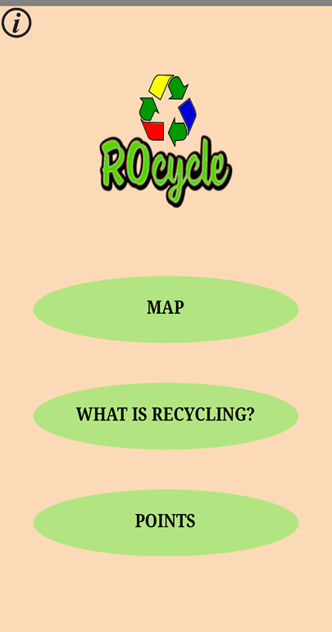

Slide 5
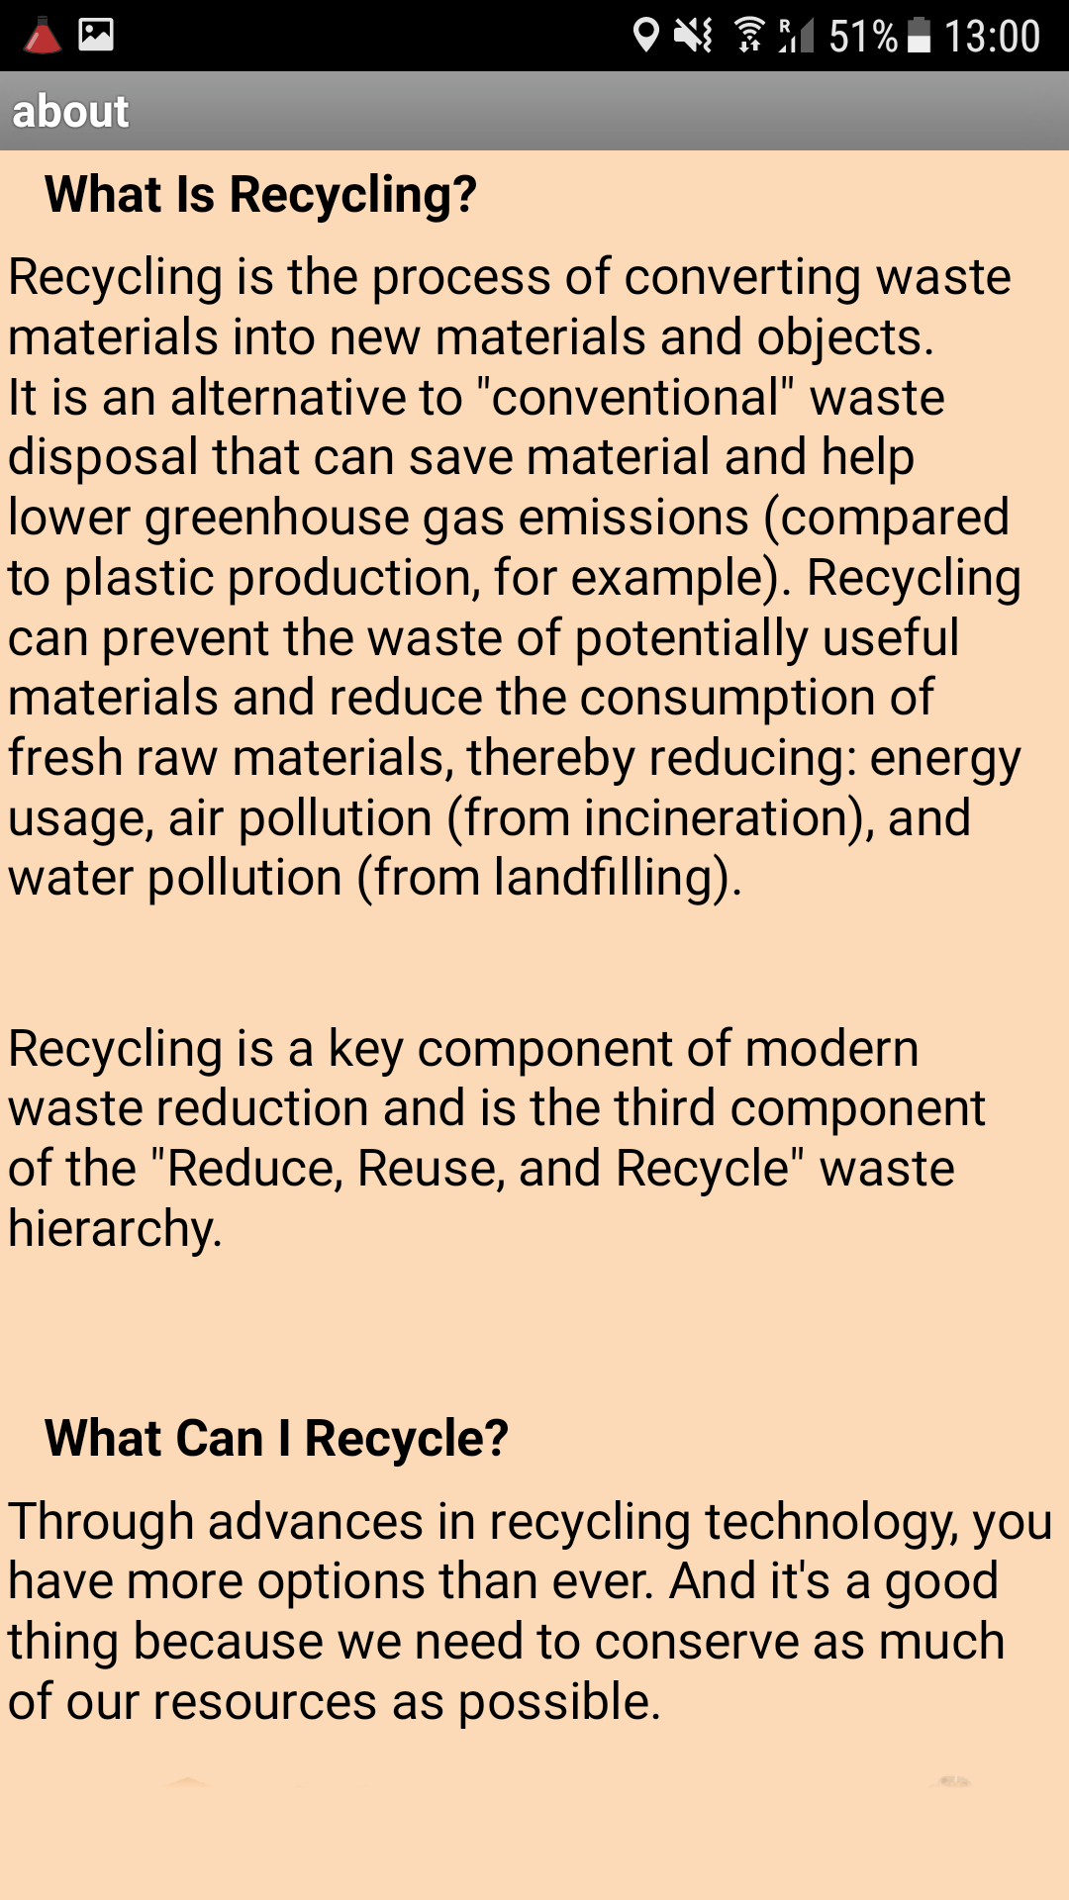

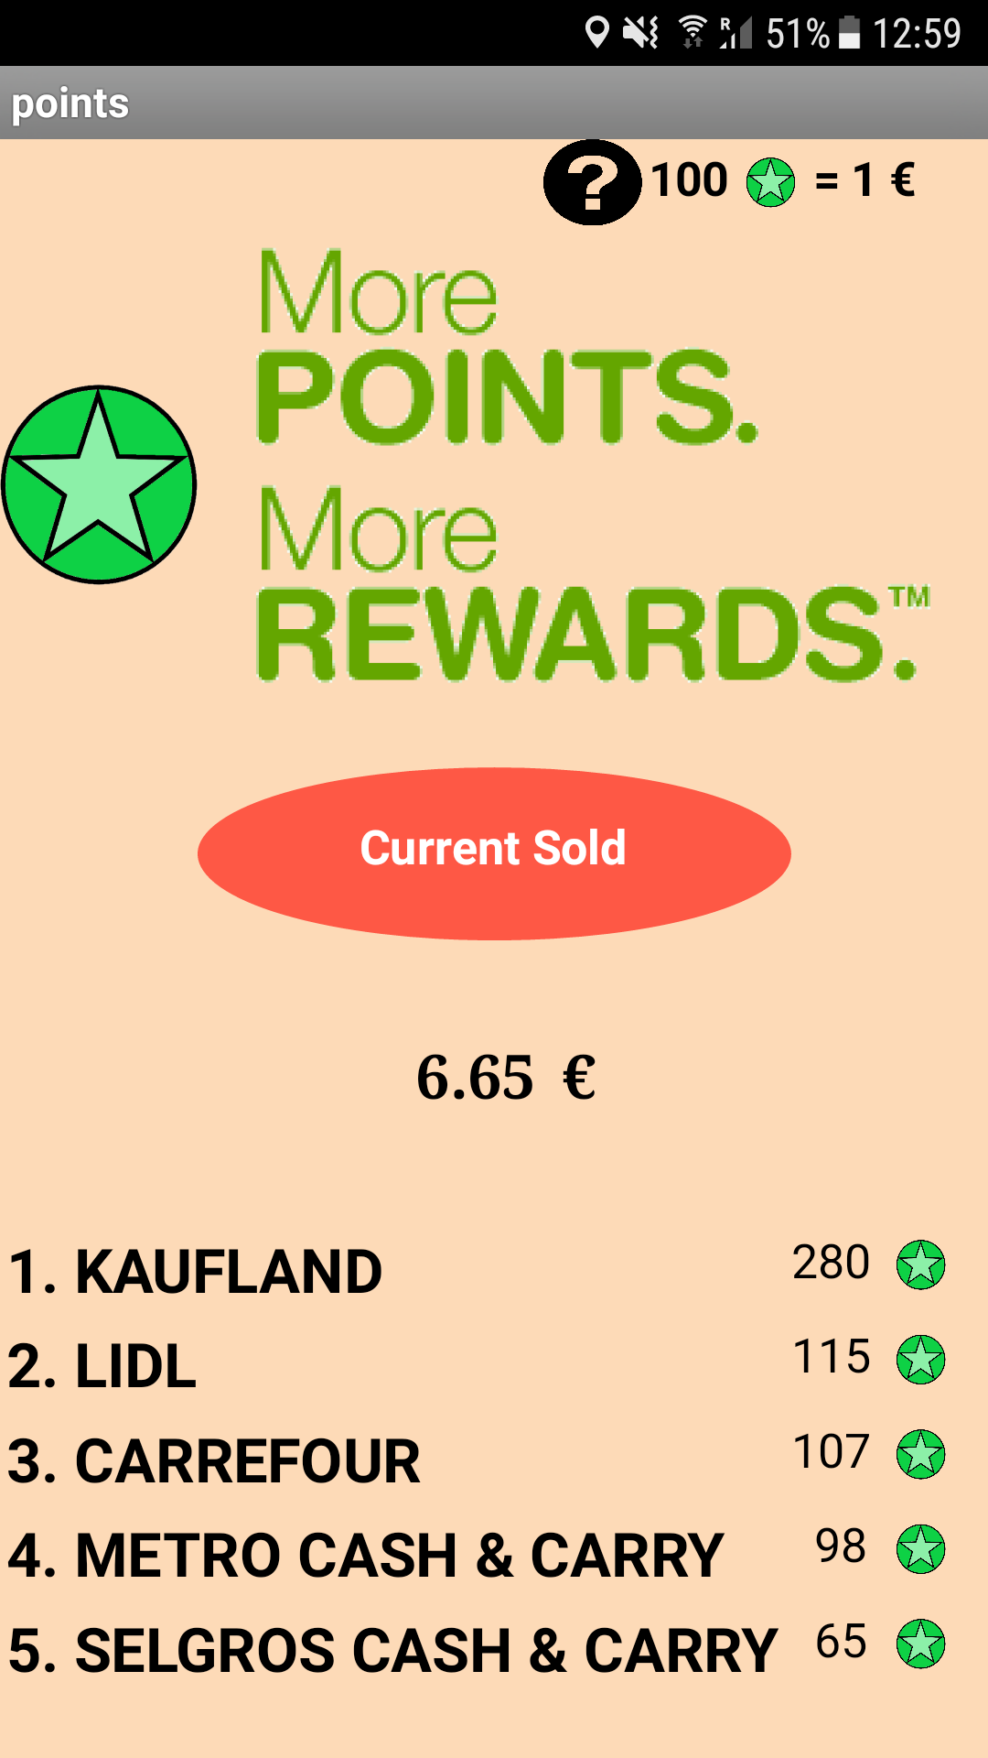
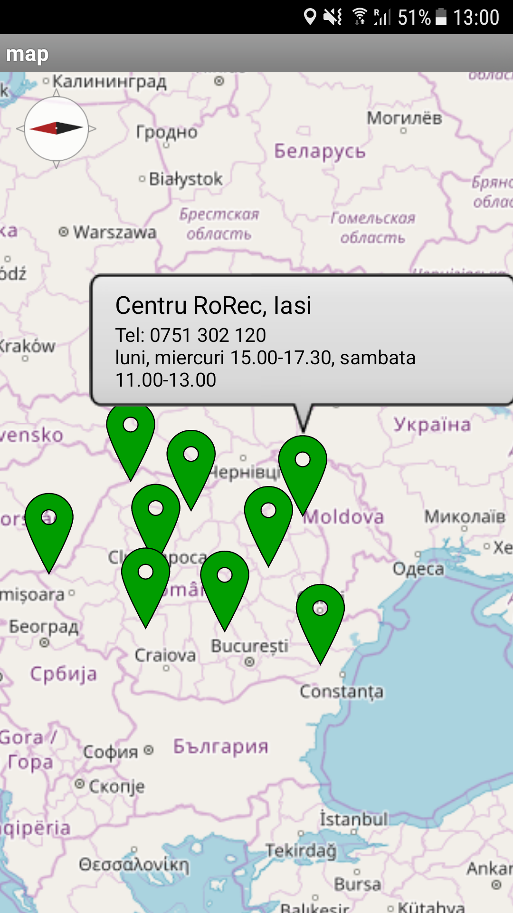

Slide 6
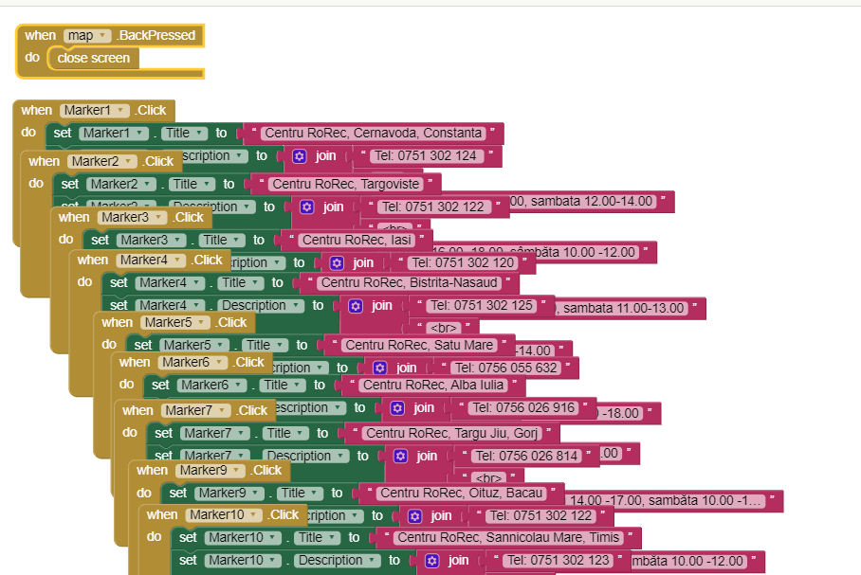

Slide 7
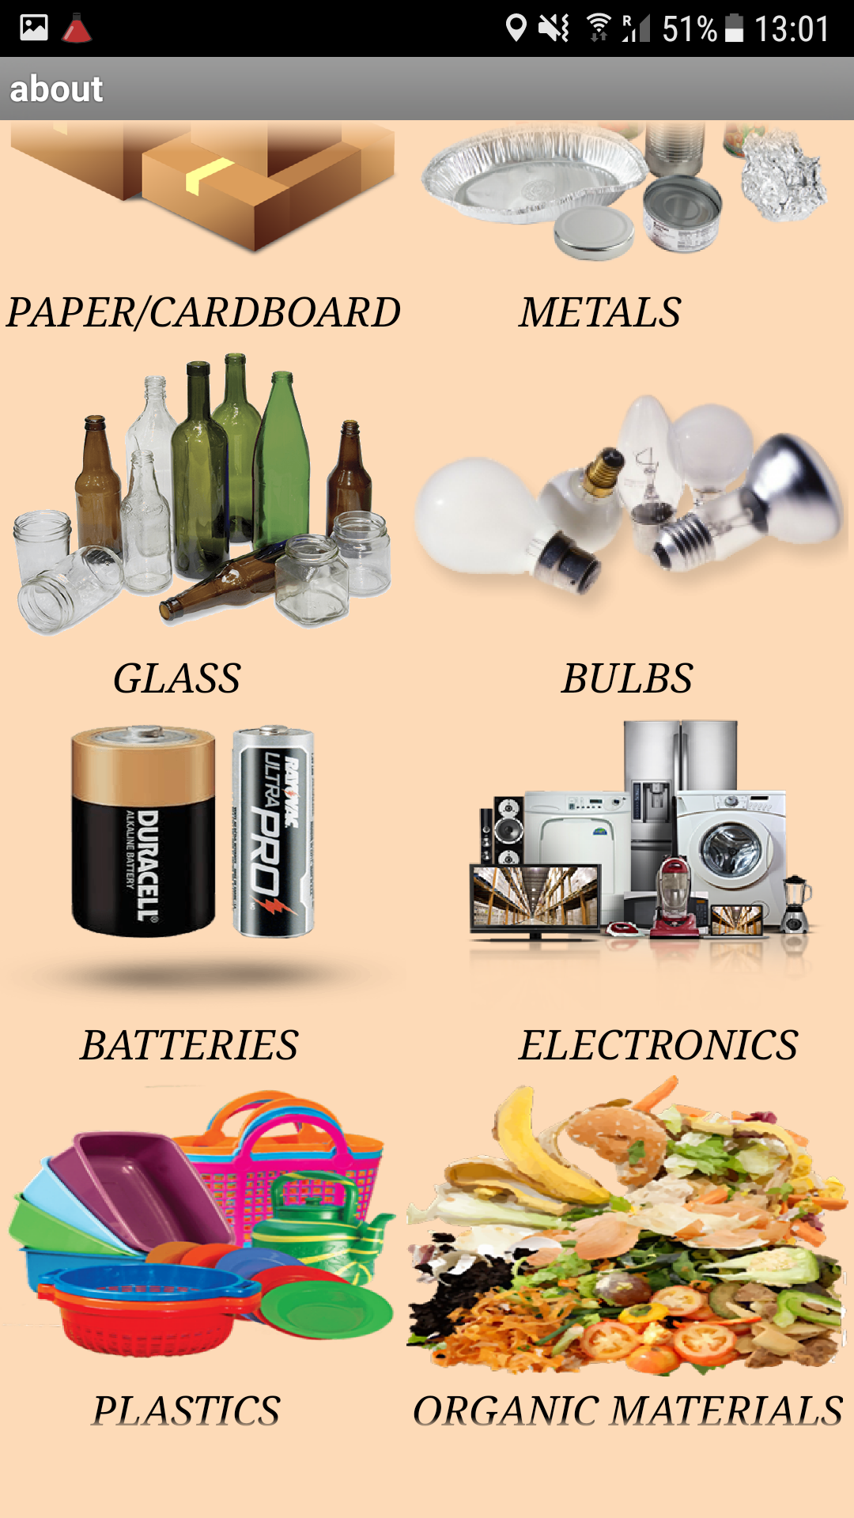
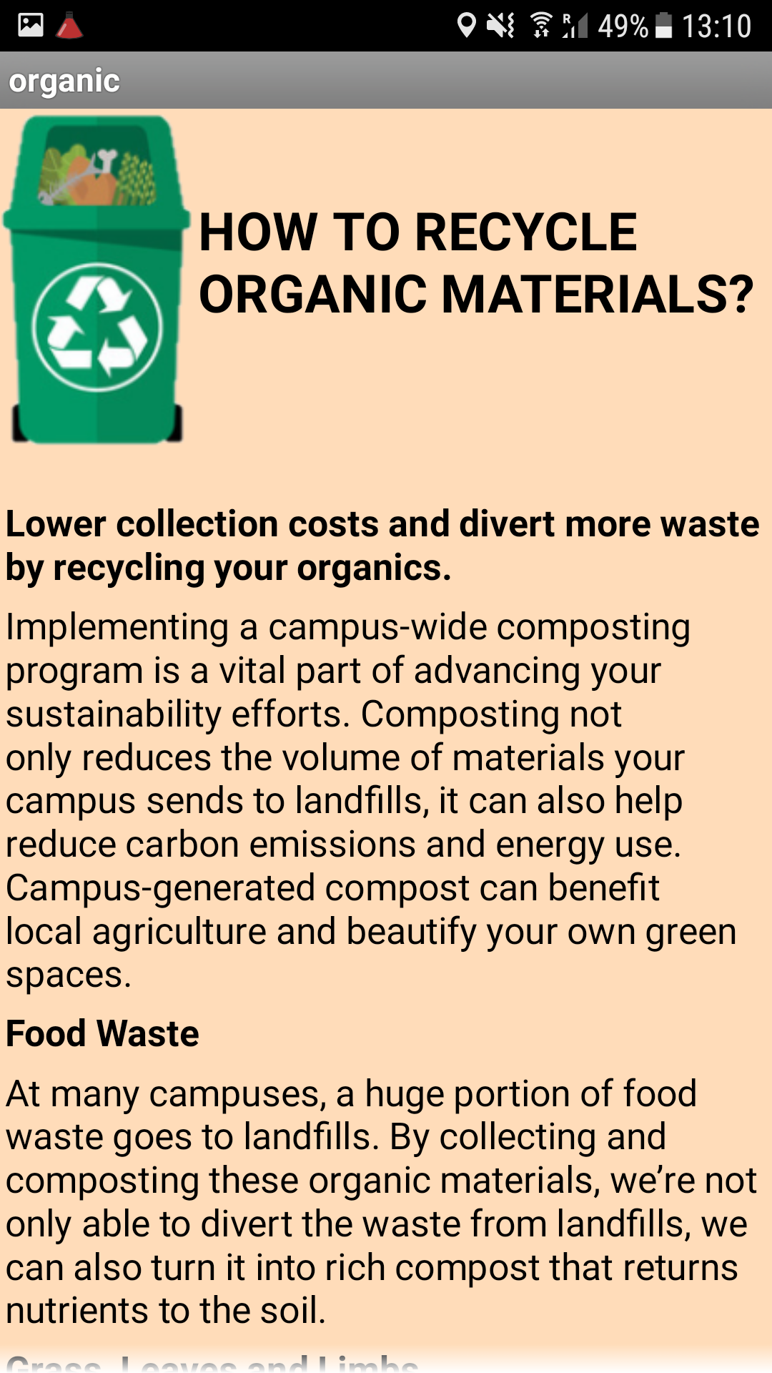

Slide 8


Slide 9
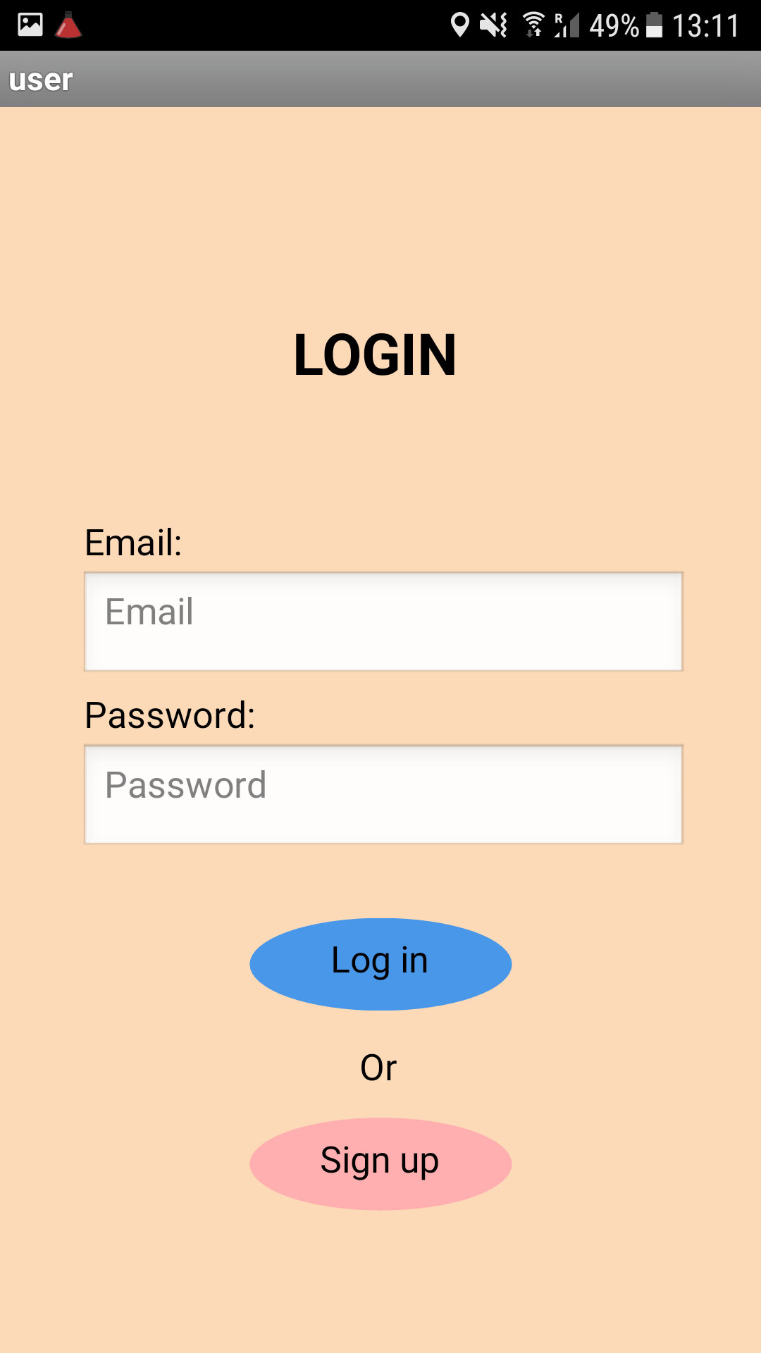
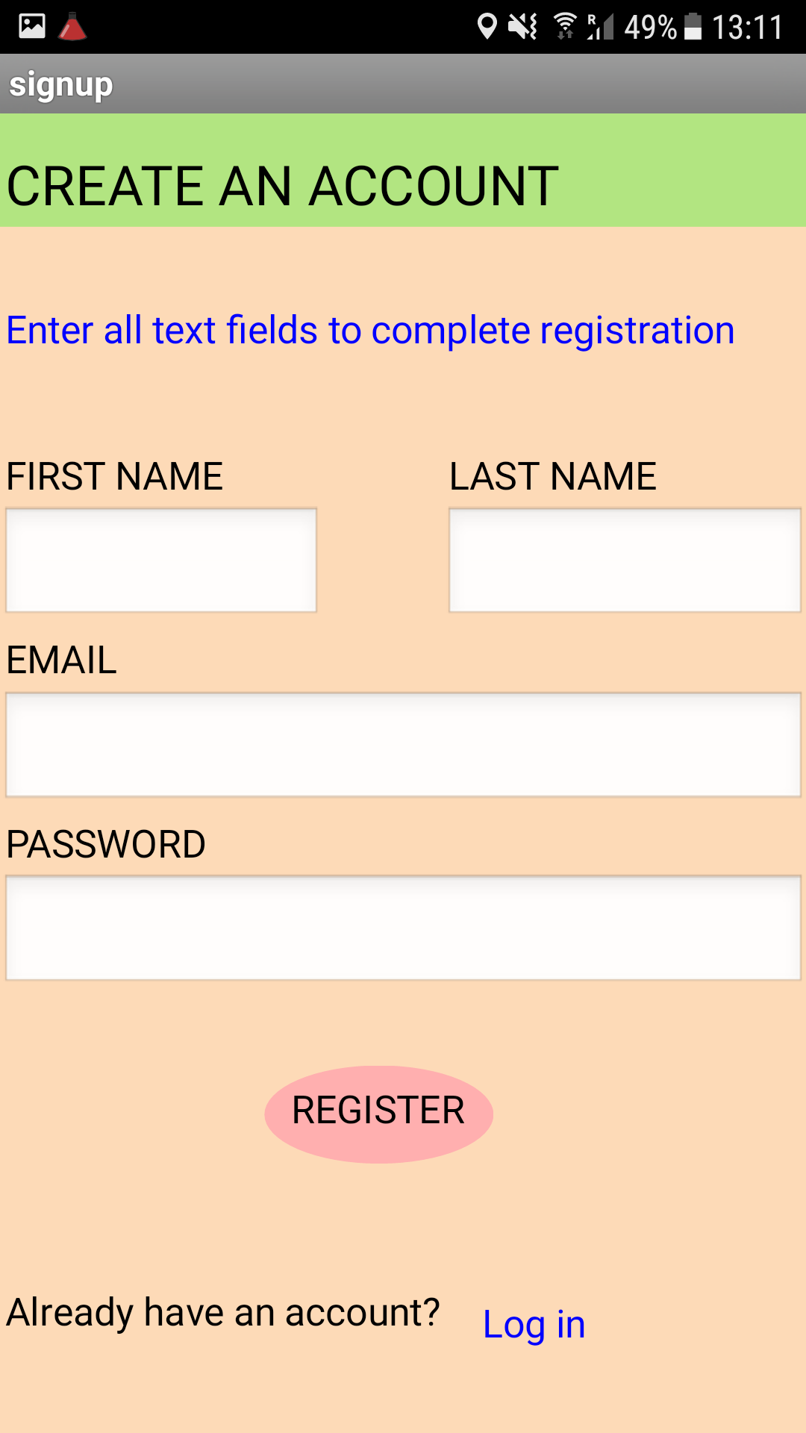
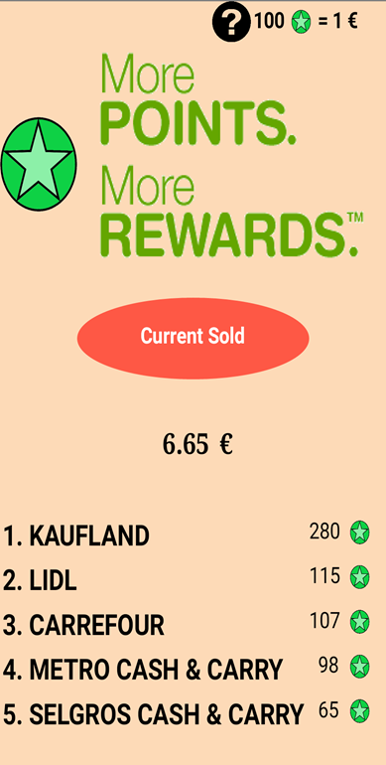

Slide 10
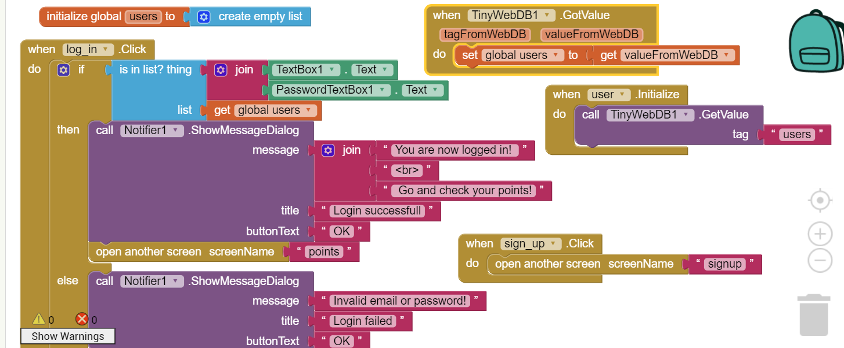
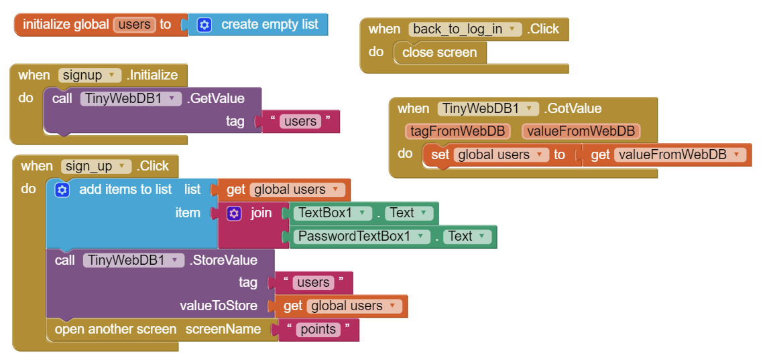

Slide 11
What we have learned
Working in a team
Being Cooperative
Taking the initiative and responsibility towards the work
Meeting deadlines
Working professionally
Being involved in different activities

Slide 12

Thank you!
Erasmus+ Programme
The mentor
Training Vision
Infonetmedia

